Slide 1
Bre-δ
Find cleaner air with the tap of a button

Slide 2

Who we are
Anna
Afroditi
Dimitra
Developer
Analyst
Environmental Scientist

Slide 3
Runs twice a week
Has a 7-month old baby
Works in Aspropyrgos
Anna
Afroditi
Dimitra
Developer
Analyst
Environmental Scientist

Slide 4




Why
90%
EU citizens are exposed
8% of deaths in GR may be attributed to pollution
8 months
Shorter life (PM-2.5)
Greece has an obligation to measure pollution

Slide 5
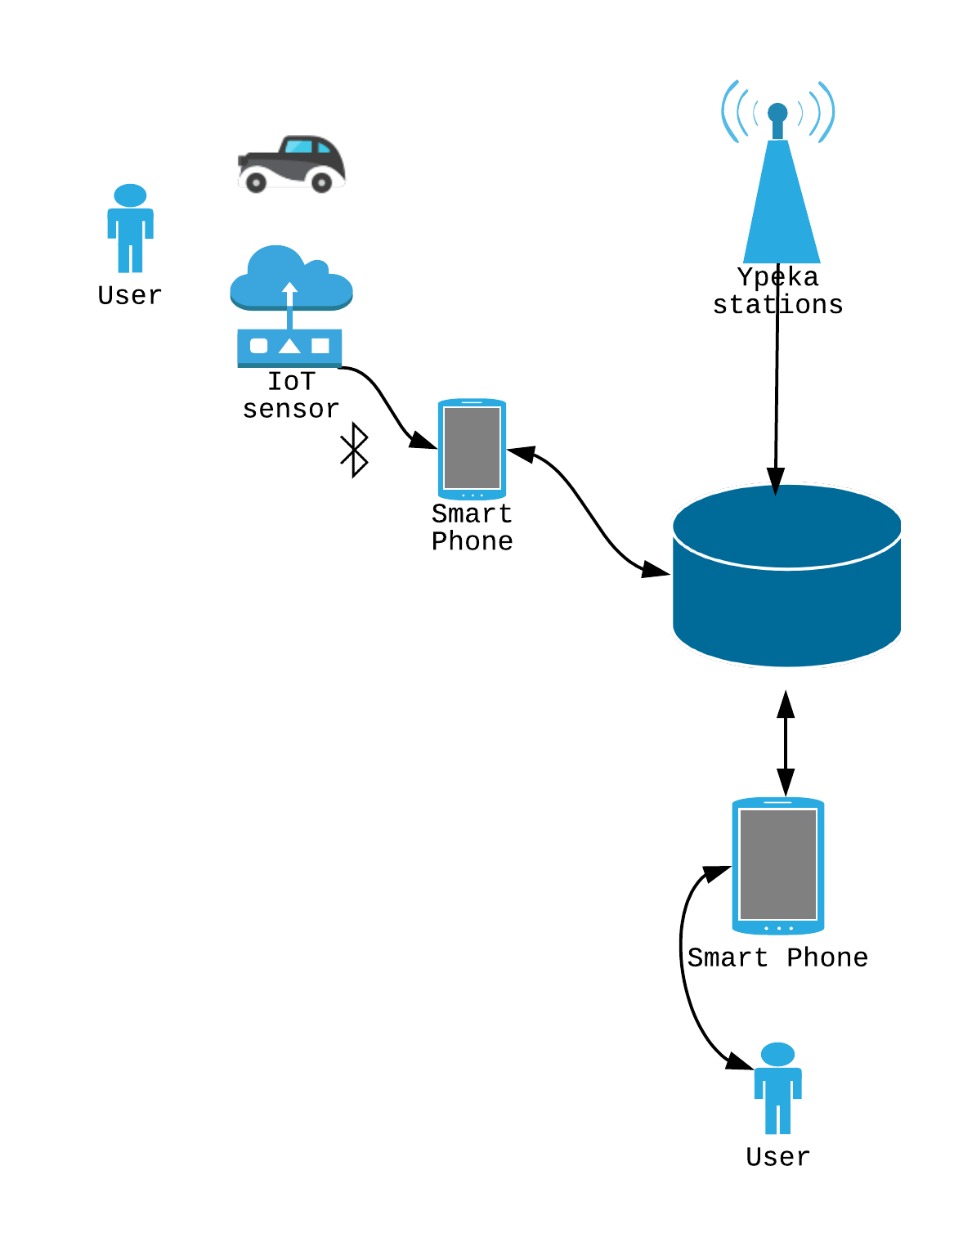



Sensors on the go
What
ΕΔΠΑΠ Ypeka.gr
Weather
Traffic
Historical: Mapsportal.ypen.gr
1. See real-time air measurements 2. Discover cleaner routes around you

Slide 6
Business Model
1
Partner
-Partner with brands, councils, local shops, scooters
2
Cost on user -Upfront cost of the sensor
-App comes for free
3
Tiers
-Free tier: postcode measurements
-Premium/personalised: sensor-based results, recommendations

Slide 7
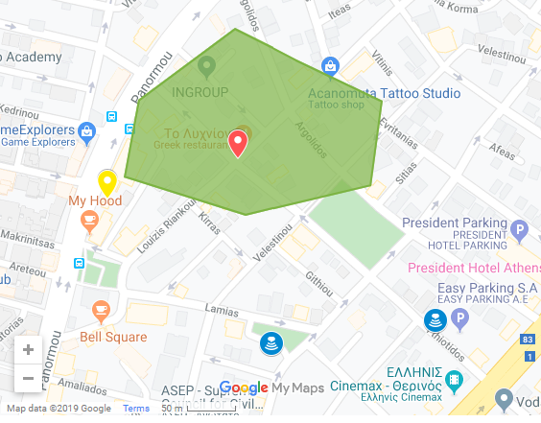
Demo
Is it a good day to go out today?
Particles | Σταθμοι ΕΔΠΑΠ | Sensor | Phone Camera
O3 | x
NO2 | x | x
SO | x
SO2 | x
CO | x
PM-1 |  | x
PM-2.5 |  | x
PM-10 | x | x | x
VOC |  | x

Slide 8




In the future
Personalisation
Link your activity and receive recommendations
Gamification
Gain credits as you choose greener routes
Inform & Educate
Evidence-based policy making
More particles
Use a larger list of pollutants

Slide 9
Sources
Slide 2: Icons made by Freepik from www.flaticon.com
Slide 5 (route): made by MadeByOliver, from flaticon.com
Slide 5 (startup, smartphone): made by Gregor Cresnar, from flaticon.com
Slide 4 (nervous): made by MadeByOliver, from flaticon.com
Slide 4(family, question): : Icons made by Freepik from www.flaticon.com
Slide 4, flying stats: http://www.iata.org/pressroom/pr/Pages/2013-12-30-01.aspx
Slide 4, nervous flier stats: http://flyfright.com/statistics/
Slide 4, zzz, rice, pacman: Icons made by Freepik from www.flaticon.com
Slide 7, heart, joystick, press, cube: Icons made by Freepik from www.flaticon.com
Slide 6: http://sedac.ciesin.columbia.edu/data/set/gpw-v4-population-count
https://plumelabs.com/en/flow/store
G.Logothetis (2017) Pollution kills 1 in 12 Greeks. Time for a massive clean up act, Medium
ΥΠΟΥΡΓΕΙΟ ΠΕΡΙΒΑΛΛΟΝΤΟΣ ΚΑΙ ΕΝΕΡΓΕΙΑΣΓΕΝ. Δ/ΝΣΗ ΠΕΡΙΒΑΛΛΟΝΤΙΚΗΣ ΠΟΛΙΤΙΚΗΣΔ/ΝΣΗ ΚΛΙΜΑΤΙΚΗΣ ΑΛΛΑΓΗΣ & ΠΟΙΟΤΗΤΑΣ ΑΤΜΟΣΦΑΙΡΑΣΤΜΗΜΑ ΠΟΙΟΤΗΤΑΣ ΤΗΣ ΑΤΜΟΣΦΑΙΡΑΣ (2018), ΕΤΗΣΙΑ ΕΚΘΕΣΗ ΠΟΙΟΤΗΤΑΣ ΤΗΣ ΑΤΜΟΣΦΑΙΡΑΣ 2018
Κ.Υ.Α. αριθμ. οικ. 70601/23.12.2013 Βραχυπρόθεσμα σχέδια δράσης για την αντιμετώπιση ατμοσφαιρικής ρύπανσης από αιωρούμενα σωματίδια

Slide 10
Thank you!

